Slide 1

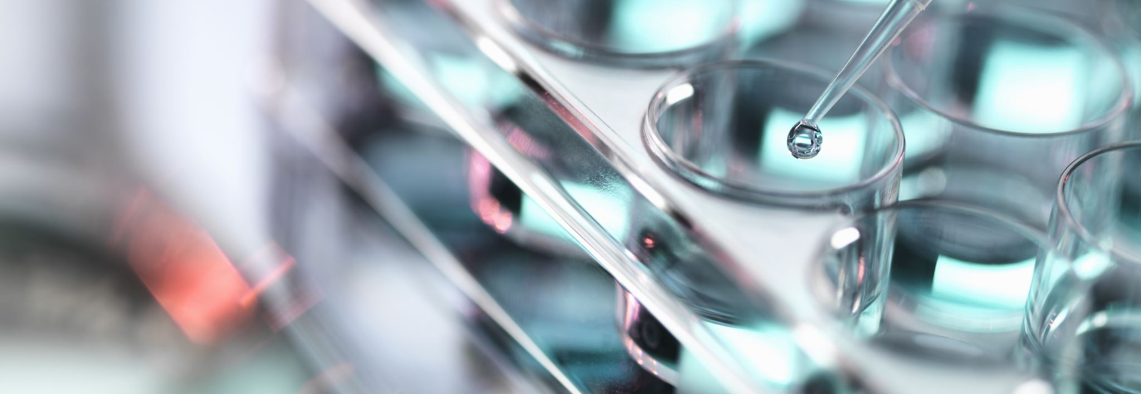

Atwood Lab Figures

Slide 2
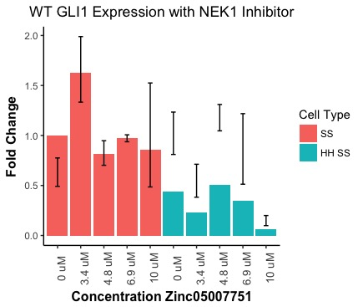
Gli Expression 3T3 NEK1 Inhibitor
NEEDS TO BE RERUN Because normalization for SE is odd!

Slide 3
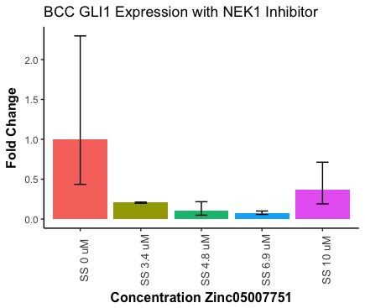
GLI Expression BCC NEK1 Inhibitor
NEEDS TO BE RERUN BECAUSE OF SD OF 0uM

Slide 4
MTT Assay Zinc (Absorbance)

Slide 5
MTT Assay Zinc (Percent Viability)

Slide 6
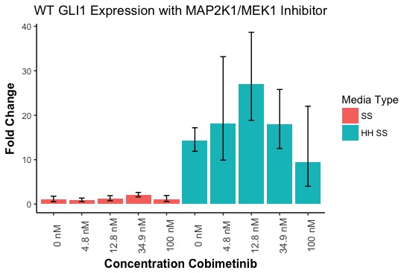
GLI Expression 3T3 MEK Inhibitor Cobi
Notes:
Should this be cell type or mediacondition?

Slide 7
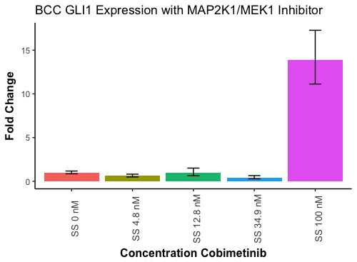
GLI Expression BCC MEK Inhibitor Cobi

Slide 8
MTT Assay Cobimetinib (Absorbance)

Slide 9
MTT Assay Cobimetinib (Percent Viability)

Slide 10
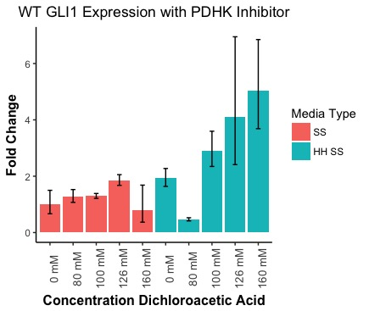
GLI Expression 3T3 PDHK Inhibitor DCAA

Slide 11
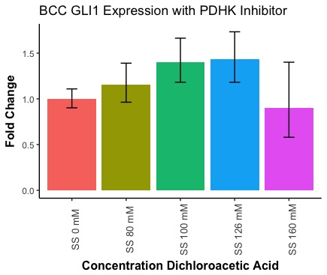
GLI Expression BCC PDHK Inhibitor DCAA

Slide 12
MTT Assay DCAA (Absorbance)

Slide 13
MTT Assay DCAA (Percent Viability)

